Slide 1
Project Fino
YOUR VERY OWN AUTOMATED BIRD FEEDER!
By loti ibrahimi

Slide 2

Project Overview
Points to be discussed.
Project Idea?
Technology Used?
Design.
Progress Made?

Slide 3
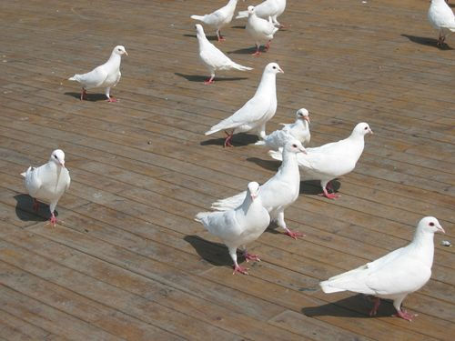
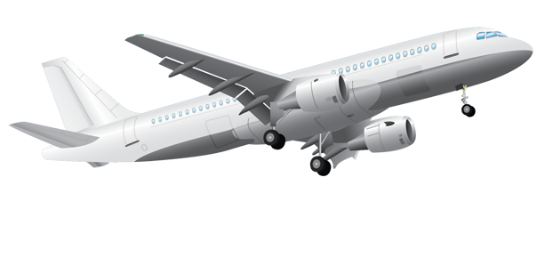
Project IDEa?
WHY I CHOOSE THIS PROJECT.
Pet Birds.
Practical.
Convenient.
Useful.
“Who will feed us?”

Slide 4

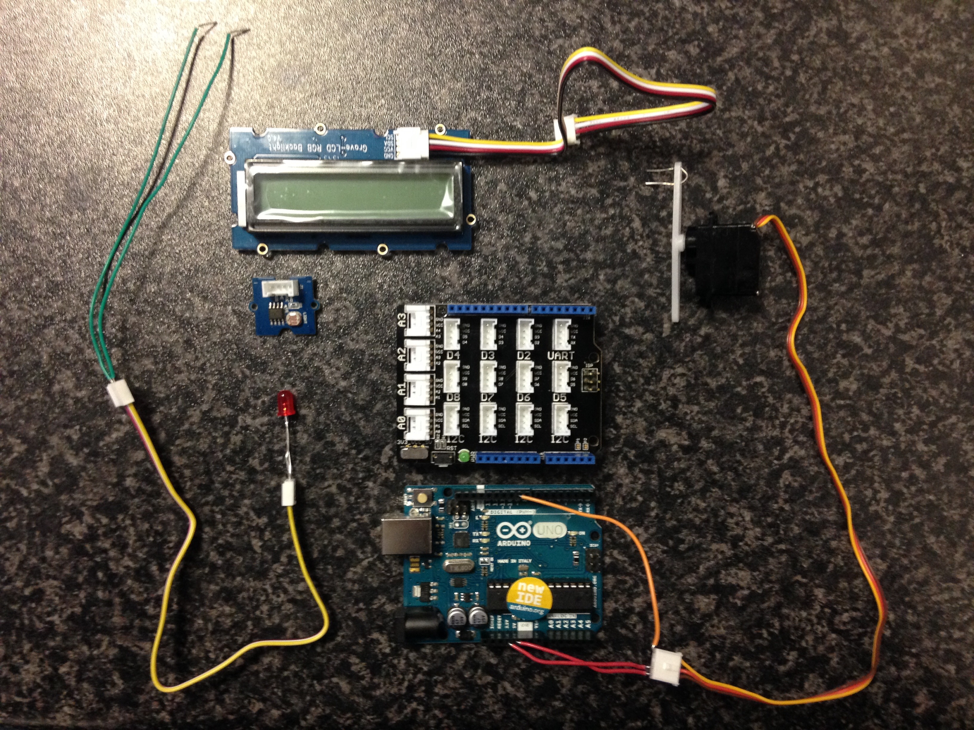
Technology / Skills Used
Automated Bird Feeder.
Grove – Light Sensor.
Grove - L.E.D (Light Source)
Grove – Servo.
Base Shield.
Arduino.
Other Module Skills:
Programming (primarily).
Computer Systems.

Slide 5
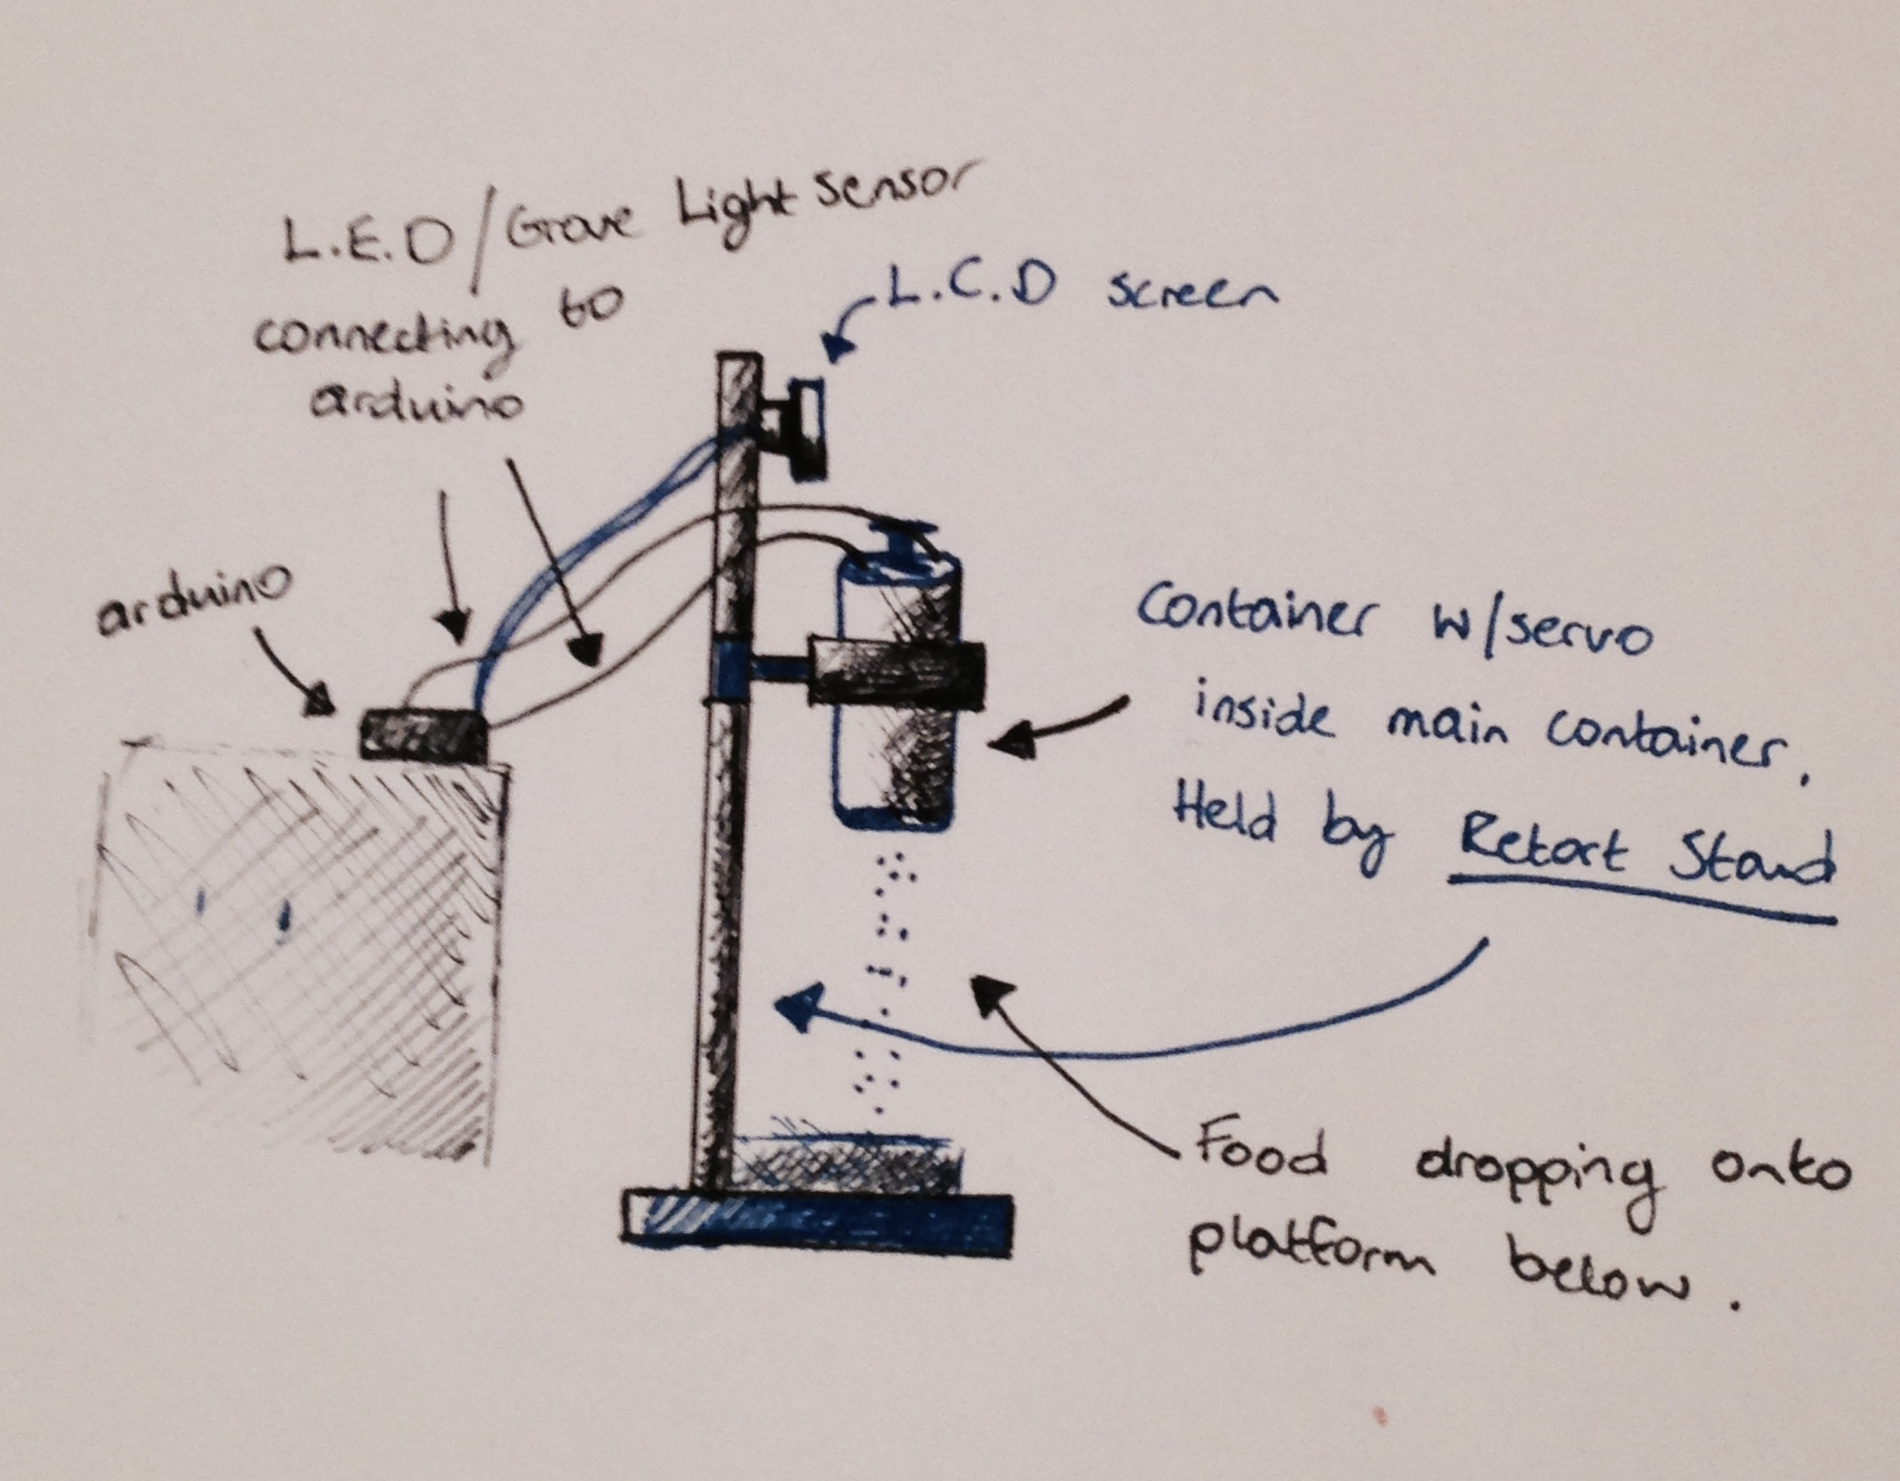
Design
FINO FUNCTIONALITY / SKETCHES
So… how would it work?
Servo Auto-Rotates.
Food falls from container.
Inner-container : [food/light sensor/L.E.D.]
Internal Reflection [reflective surface at bottom.]
If Full: L.E.D not visible.
If Empty: L.E.D visible.
Print on L.C.D screen.

Slide 6
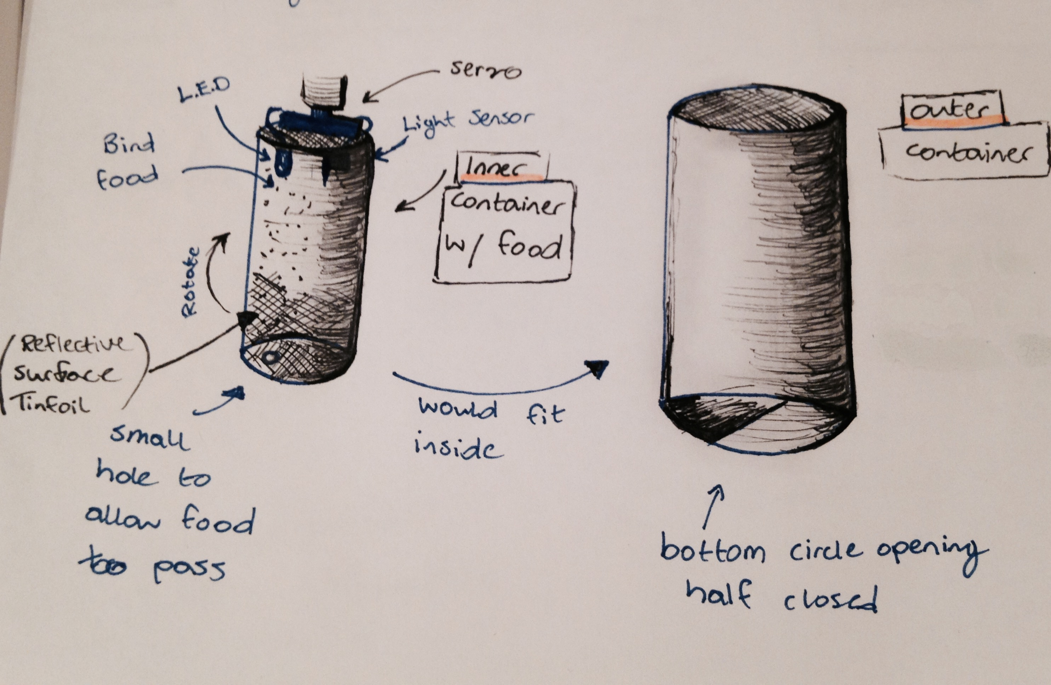
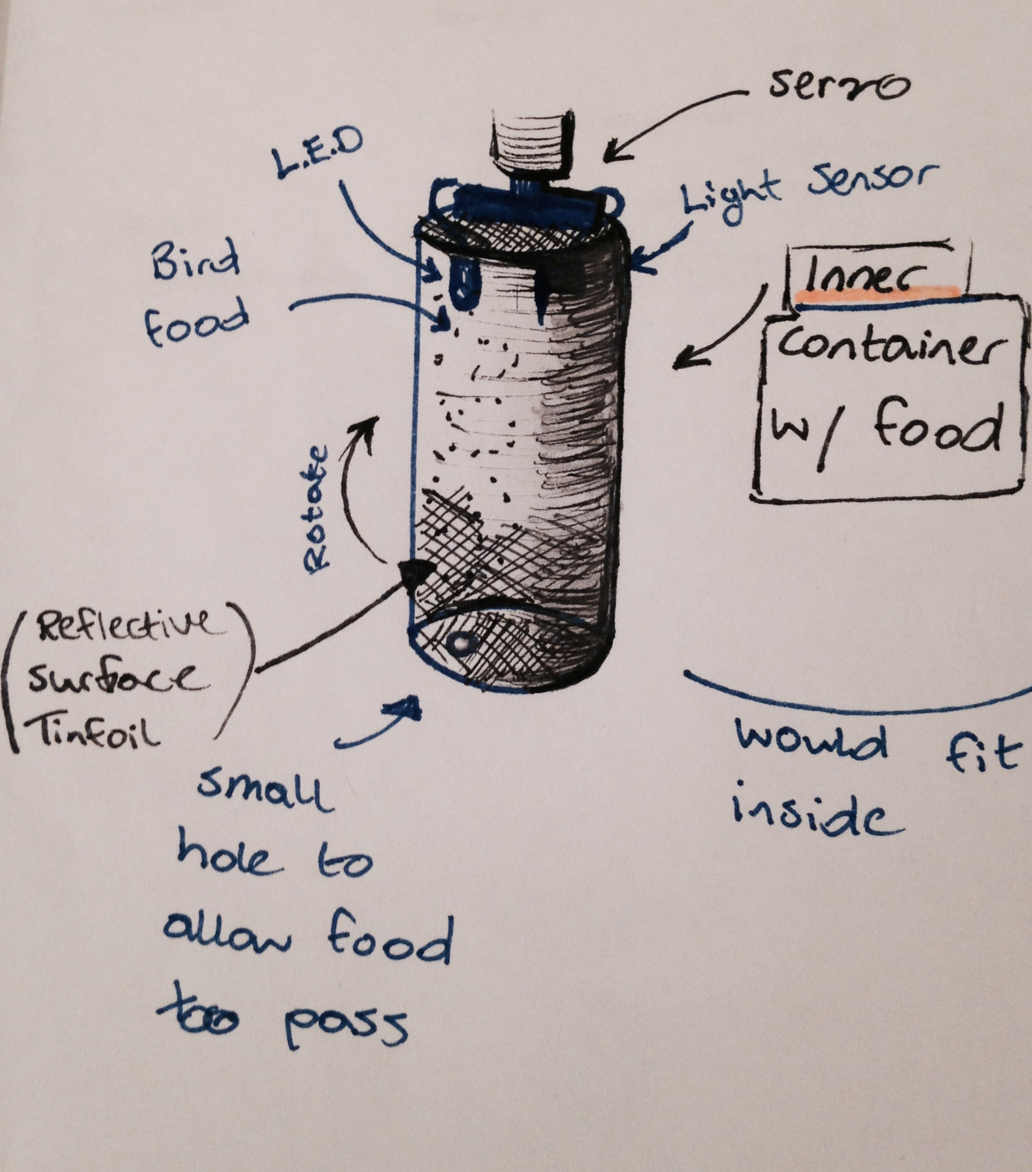
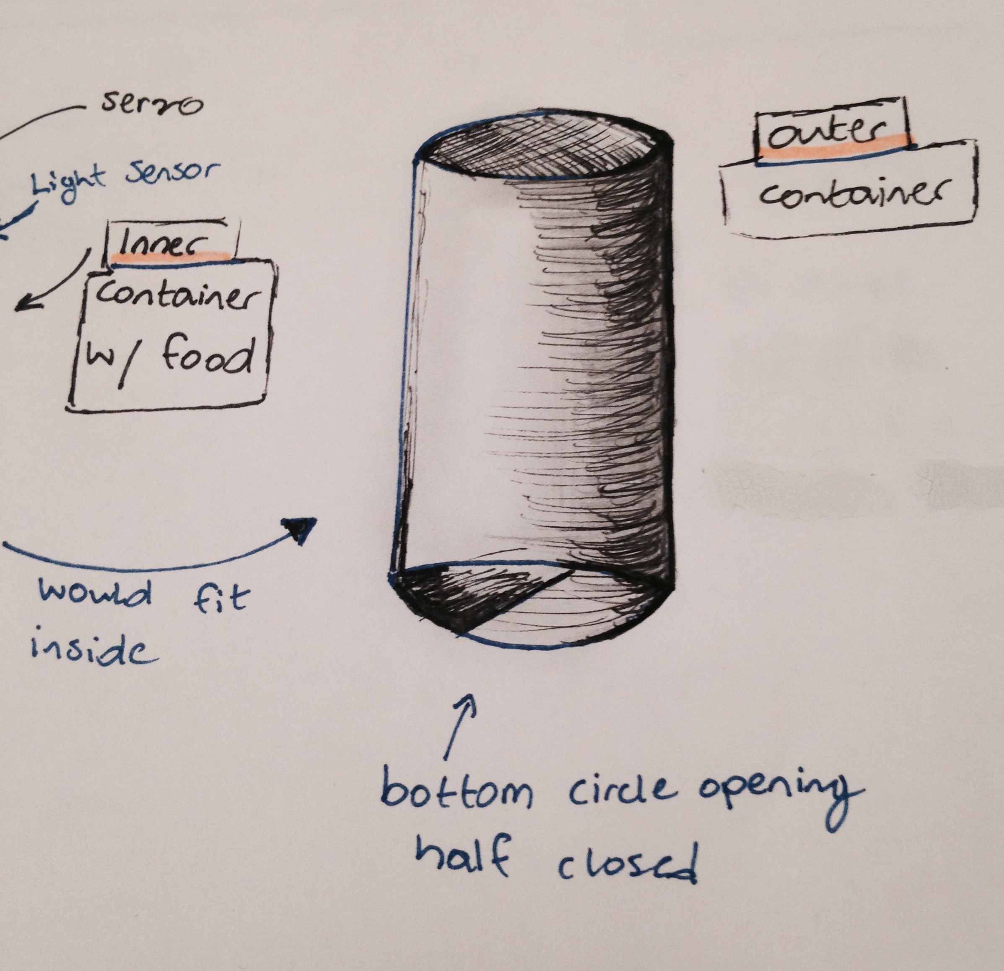
Design
FINO FUNCTIONALITY / SKETCHES

Slide 7

Progress
WHAT HAVE I DONE SO FAR?
Created a proposal.
Created a GitHub repository.
I have tested electrical components.
Experimented with the code.
Sketched out ideas/design.
Researched.
Began Website.

Slide 8
Any questions?

